Slide 1
Heuristics to help you design, build and choose test tools
Thursday 2 Oct 15:55 workshop 99 minutes Isabel Evans
University of Malta

Slide 2
Hidden slide Abstract
This workshop gives you a chance to get hands-on and deep dive into the IDEA-T framework of heuristics introduced by Isabel in an earlier TestBash talk. As a workshop attendee, you will gain access to resources that can help enable critical thinking and reflection about tools and the problems they solve. Working together in a round-table, we will see how sometimes heuristics can pinpoint when a tool might actually be the wrong answer to your problems; with the main takeaway of this workshop being that you are empowered to make smarter, evidence-based decisions in your tool design and acquisition efforts.
Level of expertise required for this workshop: Intermediate
Prerequisites:
Useful but not essential to have attended the related talk.
Useful to have laptop or something to access the online repository with the heuristics and framework.
What you’ll learn
Heuristics introduced and available to use in design, build and acquisition of test tools.
Access to a repository with additional material including explanations of the heuristics.
Evidence to support your decision making whether you supply or use test tools.

Slide 3
Introduction and Timetable

Slide 4
Purpose and Agenda
Purpose
Agenda
Get hands-on with the idea-t framework:
Heuristics introduced and available to use in design, build and acquisition of test tools.
Access to a repository with additional material including explanations of the heuristics.
Evidence to support your decision making whether you supply or use test tools.
Follows the talk this morning
Buddy up with someone who attended the talk
Introduction (this bit)
Workshop round 1 (25 mins)
Break 5 mins
Workshop round 2 (25 mins)
Prepare to present (15 mins)
Share (round the room, 15 mins total)
Wrap up

Slide 5
idea-t framework – GitHub Repository
Theme
Why?
Who?
Context?
How to navigate idea-t
Fast-path options
Case studies and usage examples
Supporting evidence
Keywords
Why? Heuristics
e.g.
Goals
Constraints
Measures
Why not
Why else
Who? Heuristics
e.g.
Experience
Communication
Learning
Who not
Who else
Context? Heuristics
e.g.
Where
Workflows
Timescales
Context not
Context else
Heuristics
Questions
Alternatives
Explanations
Activities

Slide 6
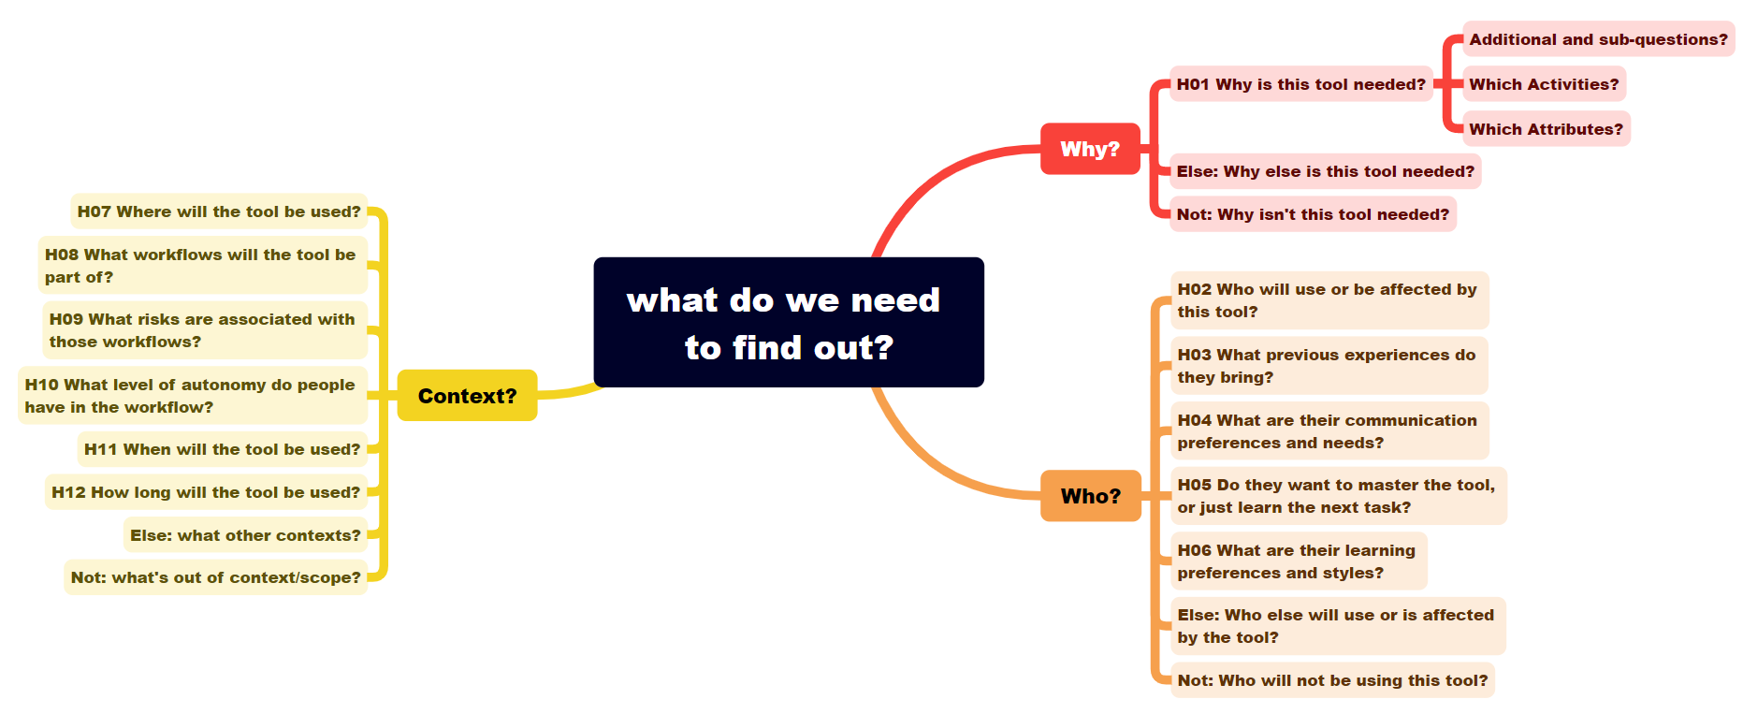

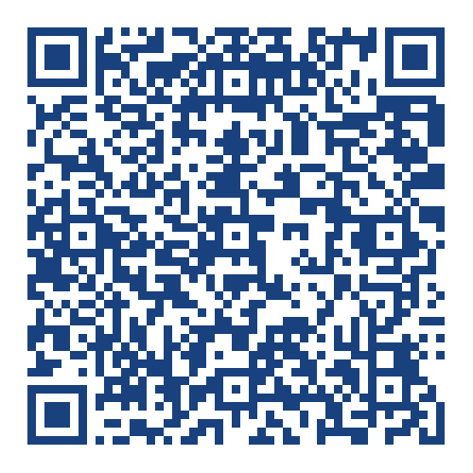
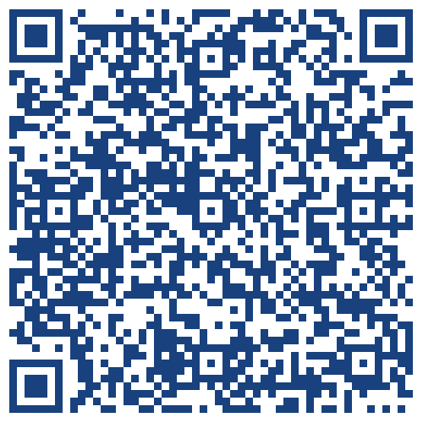

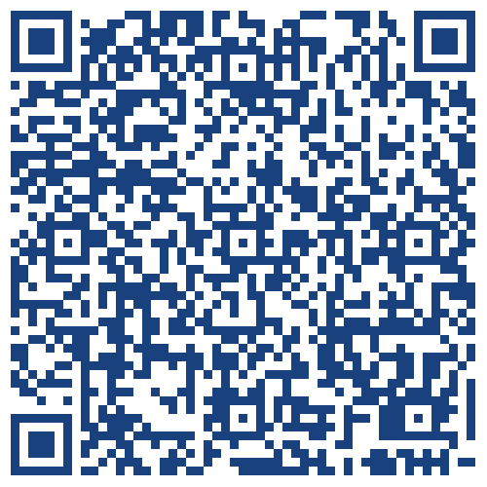
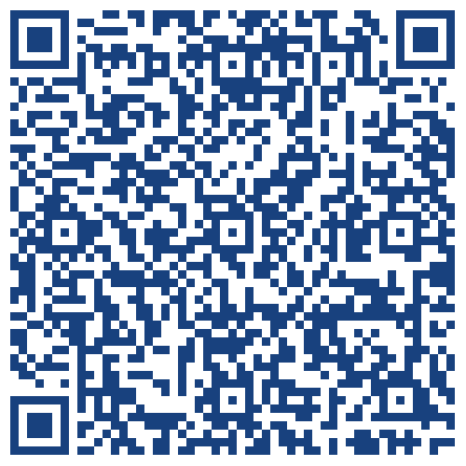

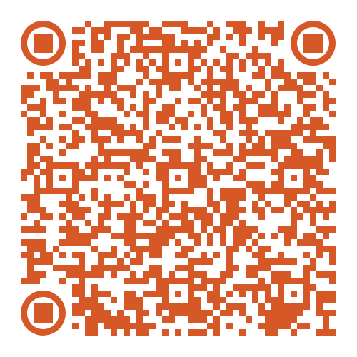
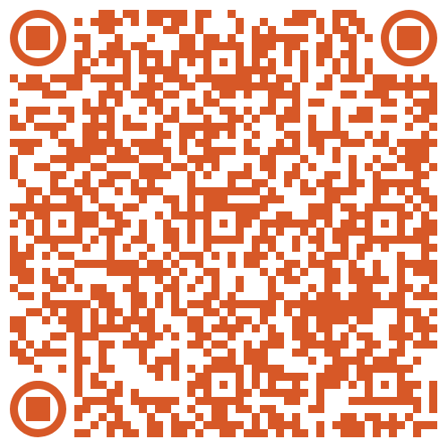
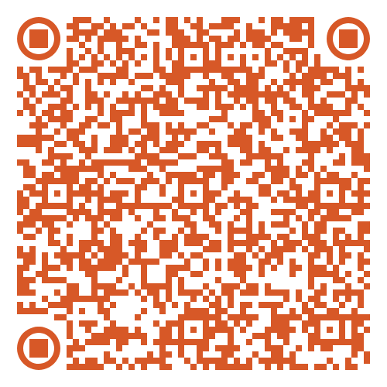
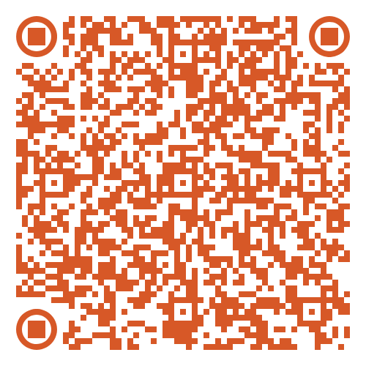
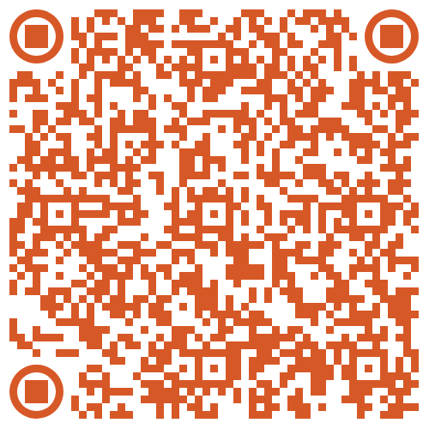
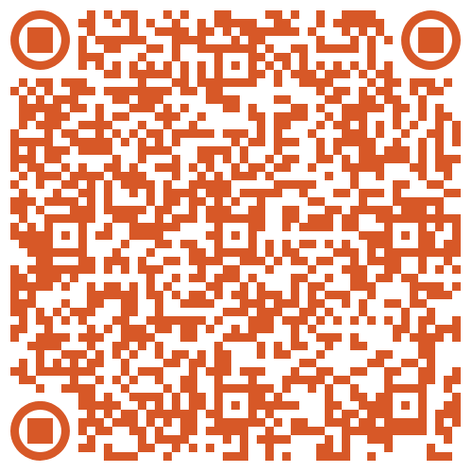
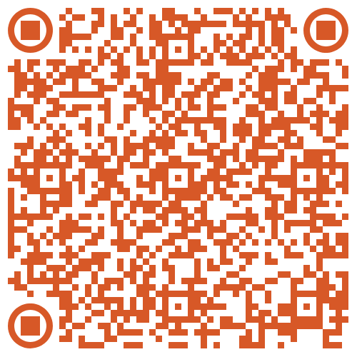
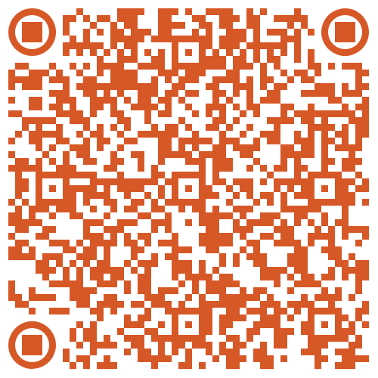
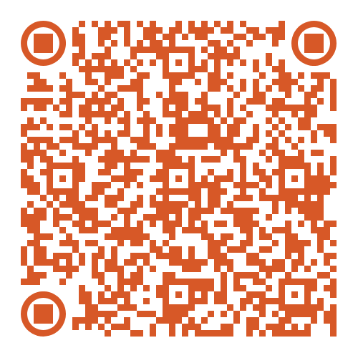
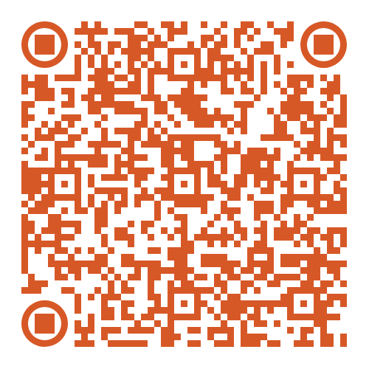
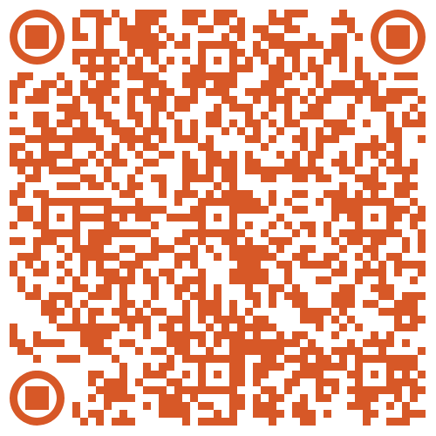
Idea-t mind map starter for TestBash October 2025 Workshop
Influencing the design-evaluation and acquisition of tools to support testing
These QR codes link to idea-t v2 draft structures and downloads
These QR codes link to v1.7 content (transfer to v2 still in progress…)
Idea-t v1.7
README page
Quick Start
page
Mind map
Xmind starter
Idea-t v2
ReadMe
page
Quality
attributes
Why?
Who?
Context?
H01
Why?
H02
Who?
H03
Experiences?
H04
Communication
H05
Mastery
or task ?
H06
Learning
style?
H07
Where?
H08
Workflows?
H09
Risks
H10
Autonomy?
H11
When?
H12
How long?
Quick Start
download
Mind map starter: bulleted list
QR code
QR code
QR code
QR code
QR code
QR code
QR code
QR code
QR code
QR code
QR code
QR code
Idea-t framework is based on research by Isabel Evans, University of Malta and is available under a GPL 3.0 license. The repository for the idea-t framework is at https://github.com/hci-lab-um/heuristics-for-test-tool-design/blob/main/README.md
Notes:
TestBash Workshop:– Bullet List version of mind map
This document is the mind map on the idea-t mind map poster, presented as a bullet list. Bullet level 1 is the centre of the mind map. Bullet level 2 is a main branch. Bullet level 3 is a subbranch. For the workshop about idea-t and on the mind map poster, only the starting skeleton of the mind map is shown, allowing teams to build their own mind map detail.
Under the subbranch “H01 Why is this tool needed?” three subbranches (starting -) at heading level 4 are shown. These could appear in every branch of the mind map, but are just shown here in the skeleton map as examples. At the end of each main branch are * Else and * Not options – again this can be used in all the sub branches as needed.
What do we need to find out?
- 1 Why?
1.1 H01 Why is this tool needed?
- Additional and sub-questions?
- Which activities?
- Which attributes?
* Else: Why else is this tool needed?
* Not: Why isn’t this tool needed?
- 2 Who?
2.1 H02
2.2 H03
2.3 H04
2.4 H05
2.5 H06
* Else:
* Not:
- 3 Context?
3.1 H07
3.2 H08
3.3 H09
3.4 H10
3.5 H11
3.6 H12
* Else:
* Not:

Slide 7
Choose a case study as a starting point
CS1 you are purchasers of a tool
CS2 you are a team building in-house tools/automation
CS3 you are setting a tooling strategy
We’ll quickly look at examples… also in handouts on table

Slide 8
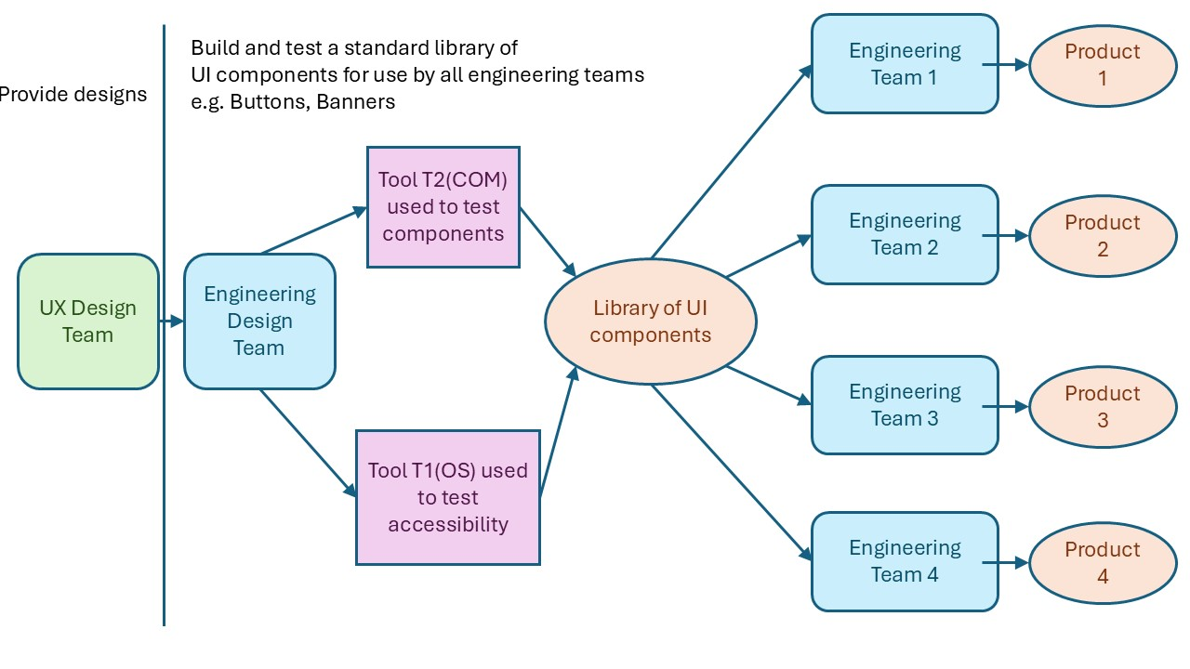
Case study 1 (acquiring tools/automation)
The case study: choosing a tool
In a similar research case study…
You are the people who will buy/use the tool not the people building/supplying the tool.
The participants used the idea-t heuristics to help them decide whether to purchase a vendor tool.
The organization’s test domain architect with representatives of the testers who would use the tool.
Rounds of meetings to:
Plan heuristics usage (1 hour meeting)
Use heuristics to discuss tool (3 hour meeting)
Identify and tackle issues (3 *1 hour meetings and follow up)
Decision
https://github.com/hci-lab-um/heuristics-for-test-tool-design

Slide 9
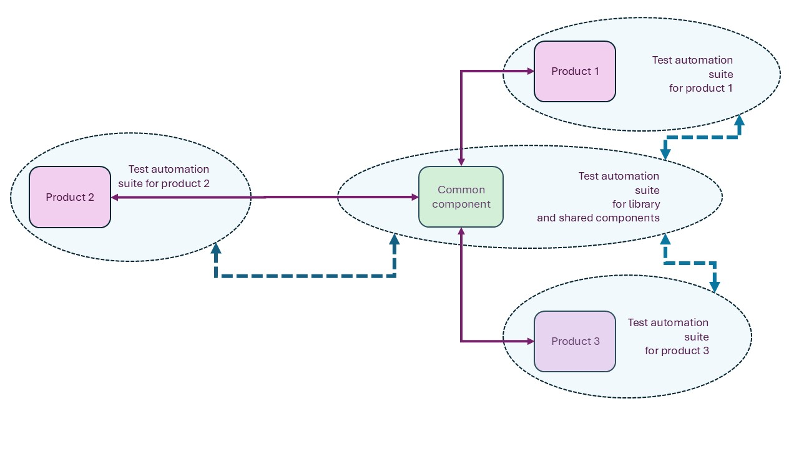
Case study 2 (building tool / automation)
The case study
In a similar research case study…
You are the people building tools and automation for use by others (and perhaps by yourselves as well)
Four people took part: Manager + 3 test automation team leads
Building automation for a team of ~500 test engineers to use.
Three test suites were reviewed to agree a common understanding of current status and next steps.
They used the heuristics to quickly understand where they had agreement, and where they needed to “deep dive” and then held workshops.
Ran a 3 hour meeting; 1 hour per suite, using the 12 heuristics as “an agenda” 5 minutes per heuristic!
https://github.com/hci-lab-um/heuristics-for-test-tool-design

Slide 10
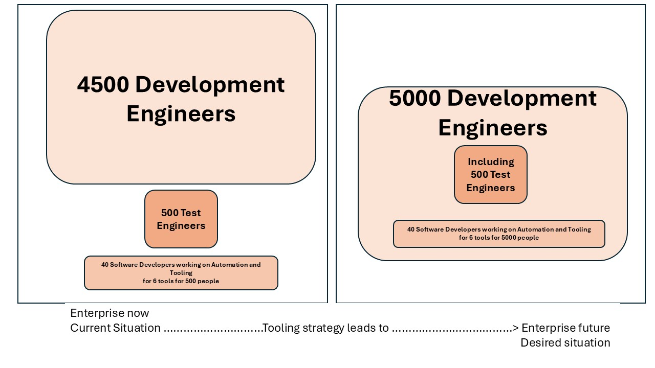
Case study 3 (setting a tooling strategy)
The case study
In a similar research case study…
You are setting the strategy for tool and automation in your testing organization.
Restructure of organization to make all 5000 development engineers responsible for use of the test tools and automation supported by 40 test automation engineers. (From 4500 developers + 500 testers +40 automation engineers)
The test tooling architect used the heuristics to review their approach to the tooling strategy and their taken for granted assumptions, looking for challenges to bias in their thinking, new ideas.
They built a mind map.
https://github.com/hci-lab-um/heuristics-for-test-tool-design

Slide 11
Round 1: 25 minutes
Rules:
Don’t reject ideas – log everything
Listen
Contribute
Explore
Based on your group’s case study:
Plan how you will use idea-t – in particular the heuristics – to explore your case study
Use the QuickStart document to engage with the heuristics
Use the “Start here” document to guide your planning
Improvise around the equivalent research case study as guidance
Decide your goal for using idea-t
Decide what order you would tackle the themes and heuristics
Decide who you would involve (in real life)
https://github.com/hci-lab-um/heuristics-for-test-tool-design

Slide 12
Break 5 minutes

Slide 13
Round 2: 25 minutes
Rules:
Don’t reject ideas – log everything
Listen
Contribute
Explore
Based on your group’s case study:
Build up one branch of the mind map (use post-its for nodes so you can move them)
Explore the idea-t framework for prompts for sub questions, explanations and evidence
Example order: theme -> heuristic -> QR code link -> subquestions and evidence -> attributes
https://github.com/hci-lab-um/heuristics-for-test-tool-design

Slide 14
Prepare to present (15 mins)
Rules:
Don’t reject ideas – log everything
Listen
Contribute
Explore
“Finish” by:
Identifying what you have found out;
Identifying decisions you have made;
Identifying where there is not agreement across the group;
Identifying where you need a deep dive.
Prepare
Make a poster or flipchart or… hold up your mind map?
Decide who will present on behalf of your group!
Main messages:
Starting point.
Finish point.
What you learnt.
https://github.com/hci-lab-um/heuristics-for-test-tool-design

Slide 15
Share your work!
Rules for audience:
Listen
Rules for presenting team:
Keep to your time!
Keep to time!
Be clear, speak up
Round the room 15 mins total – keep it brief!
Case study 1
Case study 2
Case study 3

Slide 16
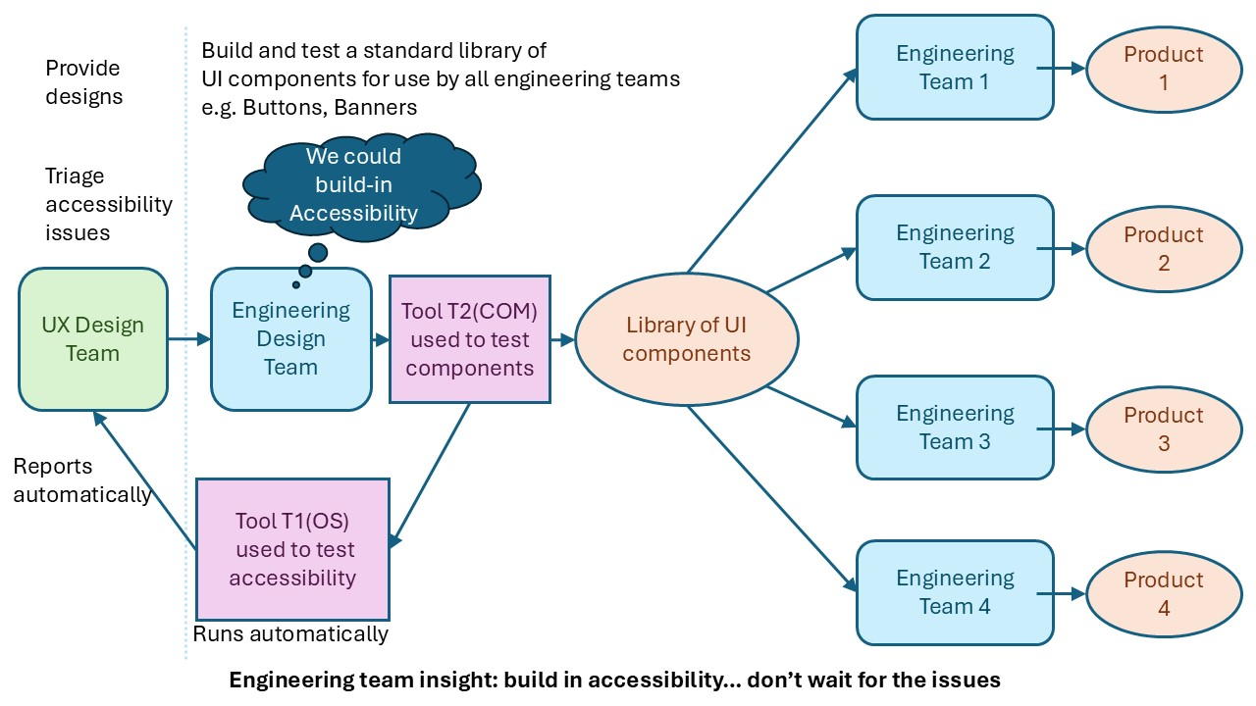
If you looked at case study 1…

Slide 17
If you looked at case study 2…

Slide 18
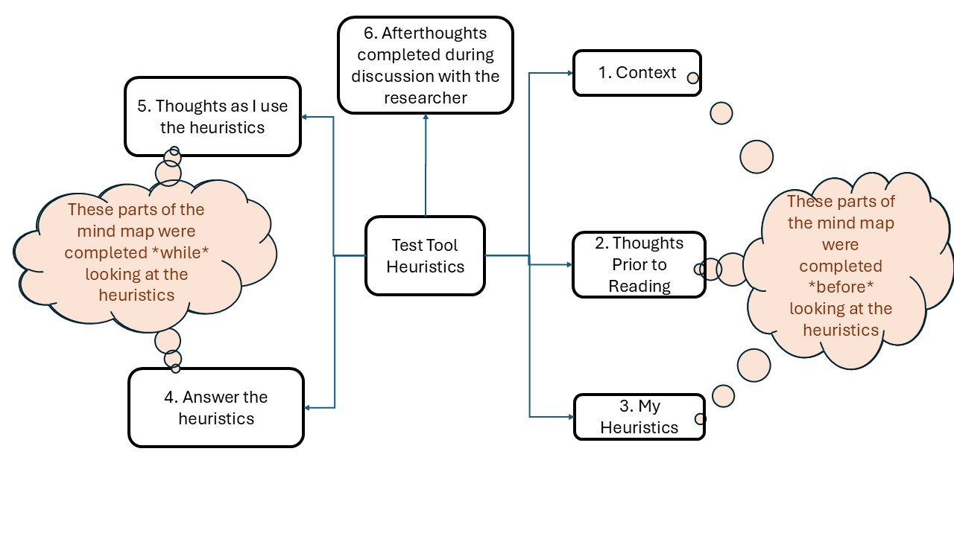
If you looked at case study 3…

Slide 19
Wrap up

Slide 20
Thank you and enjoy the rest of the conference!

